Slide 1
Assignment 3 Mini Research about Data Warehouse Concepts
Submitted by
Basavraj Jaliminche
Student id-8800149
Data Warehouse implementation

Slide 2
Q.1What is OLTP vs. OLAP?
 | OLTP | OLAP
Characteristics | Handles a large number of small transactions | Handles large volumes of data with complex queries
Query types | Simple standardized queries | Complex queries
Operations | Based on INSERT, UPDATE, DELETE commands | Based on SELECT commands to aggregate data for reporting
Response time | Milliseconds | Seconds, minutes, or hours depending on the amount of data to process
Design | Industry-specific, such as retail, manufacturing, or banking | Subject-specific, such as sales, inventory, or marketing
Source | Transactions | Aggregated data from transactions
Purpose | Control and run essential business operations in real time | Plan, solve problems, support decisions, discover hidden insights

Slide 3
 | OLTP | OLAP
Data updates | Short, fast updates initiated by user | Data periodically refreshed with scheduled, long-running batch jobs
Space requirements | Generally small if historical data is archived | Generally large due to aggregating large datasets
Backup and recovery | Regular backups required to ensure business continuity and meet legal and governance requirements | Lost data can be reloaded from OLTP database as needed in lieu of regular backups
Productivity | Increases productivity of end users | Increases productivity of business managers, data analysts, and executives
Data view | Lists day-to-day business transactions | Multi-dimensional view of enterprise data
User examples | Customer-facing personnel, clerks, online shoppers | Knowledge workers such as data analysts, business analysts, and executives
Database design | Normalized databases for efficiency | Denormalized databases for analysis

Slide 4
Q.2 What is the Kimball vs Inmon Dimensional Models?
Kimball | Inmon
Kimball: Kimball’s approach to designing a Dataware house was introduced by Ralph Kimball. This approach starts with recognizing the business process and questions that Datawarehouse has to answer. These sets of information are being analysed and then documented well. The Extract Transform Load software brings all data from multiple data sources called data marts and then is loaded into a common area called staging. Then this is transformed into an OLAP cube. Applications: Setup and Built are quick. Generating report against multiple star schema is very successful. Database operations are very effective. Occupies less space in the database and management is easy. | Inmonis approach to designing Datawarehouse was introduced by Bill Inmon. This approach starts with a corporate data model. This model recognizes key areas and also takes care of customers, products, and vendors. This model serves for the creation of a detailed logical model which is used for major operations. Details and models are then used to develop a physical model. This model is normalized and makes data redundancy less. This is a complex model that is difficult to be used for business purposes for which data marts are created and each department is able to use it for their purposes. Applications: The data warehouse is very flexible to changes. Business processes can be understood very easily. Reports can be handled across enterprises. ETL process is very less prone to errors.

Slide 5
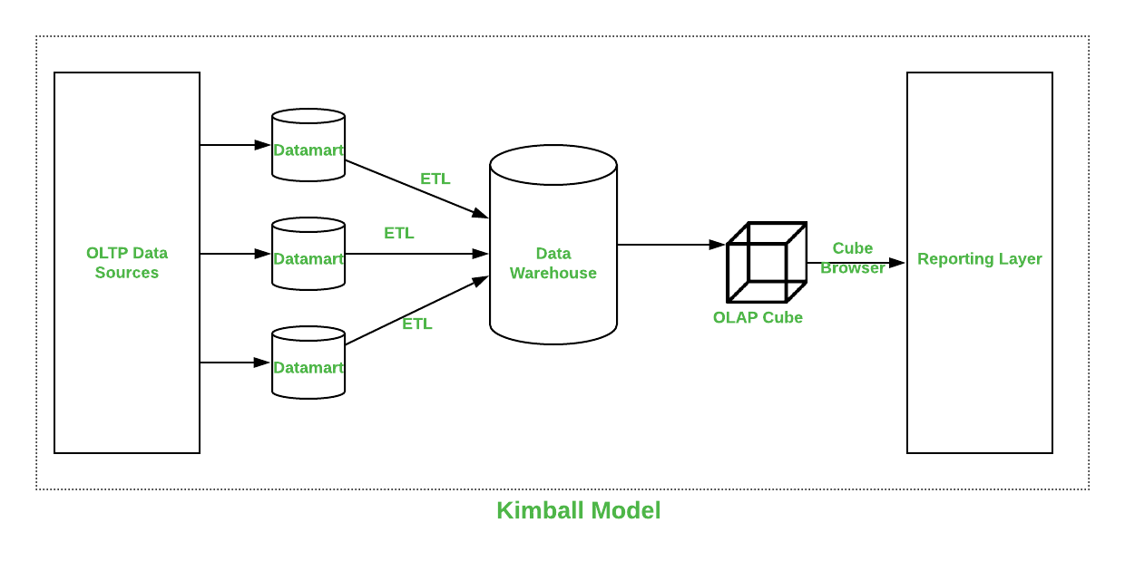
Kimball | Inmon

Slide 6
 | Kimball | Inmon
Introduced by | Introduced by Ralph Kimball. | Introduced by Bill Inmon.
Approach | It has a Bottom-Up Approach for implementation. | It has Top-Down Approach for implementation.
Data Integration | It focuses on Individual business areas. | It focuses on Enterprise-wide areas.
Building Time | It is efficient and takes less time. | It is complex and consumes a lot of time.
Cost | It has iterative steps and is cost-effective. | Initial cost is huge and the development cost is low.
Skills Required | It does not need such skills but a generic team will do the job. | It needs specialized skills to make work.
Maintenance | Here maintenance is difficult. | Here maintenance is easy.

Slide 7
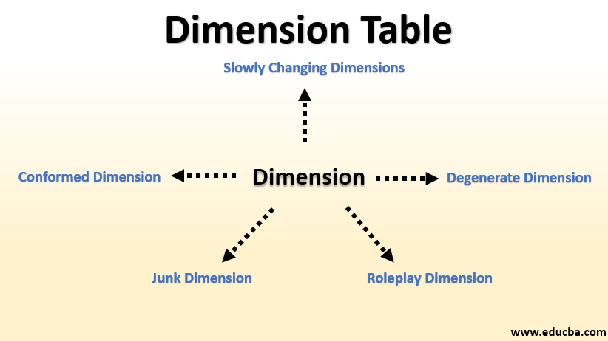
q.3 What is the dimension table, and what is the fact table?
Dimension Table : A Dimension Table is a table in a star schema of a data warehouse. Data warehouses are built using dimensional data models which consist of fact and dimension tables. Dimension tables are used to describe dimensions; they contain dimension keys, values and attributes.

Slide 8
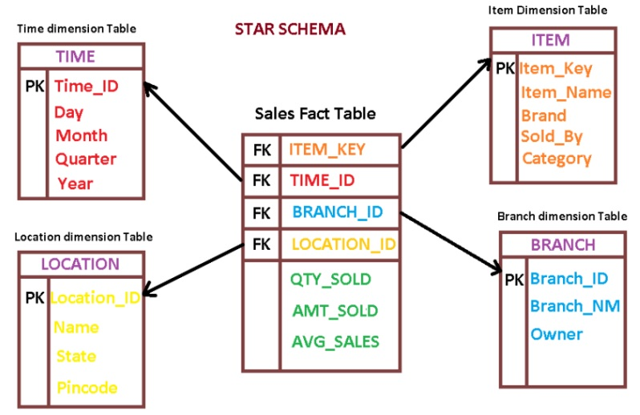
2. Fact Table : A fact table is used in the dimensional model in data warehouse design. A fact table is found at the center of a star schema or snowflake schema surrounded by dimension tables . A fact table consists of facts of a particular business process e.g., sales revenue by month by product. Facts are also known as measurements or metrics. A fact table record captures a measurement or a metric.

Slide 9
Parameters | Fact Table | Dimention Table
Characteristic | Located at the center of a star or snowflake schema and surrounded by dimensions. | Connected to the fact table and located at the edges of the star or snowflake schema
Design | Defined by their grain or its most atomic level. | Should be wordy, descriptive, complete, and quality assured.
Task | Fact table is a measurable event for which dimension table data is collected and is used for analysis and reporting. | Collection of reference information about a business.
Type of Data | Facts tables could contain information like sales against a set of dimensions like Product and Date. | Evert dimension table contains attributes which describe the details of the dimension. E.g., Product dimensions can contain Product ID, Product Category, etc.
Key | Primary Key in fact table is mapped as foreign keys to Dimensions. | Dimension table has a primary key columns that uniquely identifies each dimension.
Storage | Helps to store report labels and filter domain values in dimension tables. | Load detailed atomic data into dimensional structures.
Hierarchy | Does not contain Hierarchy | Contains Hierarchies. For example Location could contain, country, pin code, state, city, etc.

Slide 10
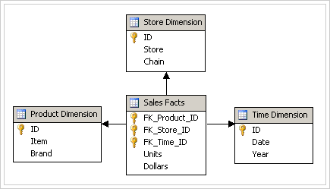
q.4 Describe the different type of schemas for Dimensional model?
There are four types of schemas are available in data warehouse. Out of which the star schema is mostly used in the data warehouse designs. The second mostly used data warehouse schema is snow flake schema. Star Schema: A star schema is the one in which a central fact table is sourrounded by denormalized dimensional tables. A star schema can be simple or complex. A simple star schema consists of one fact table where as a complex star schema have more than one fact table.

Slide 11
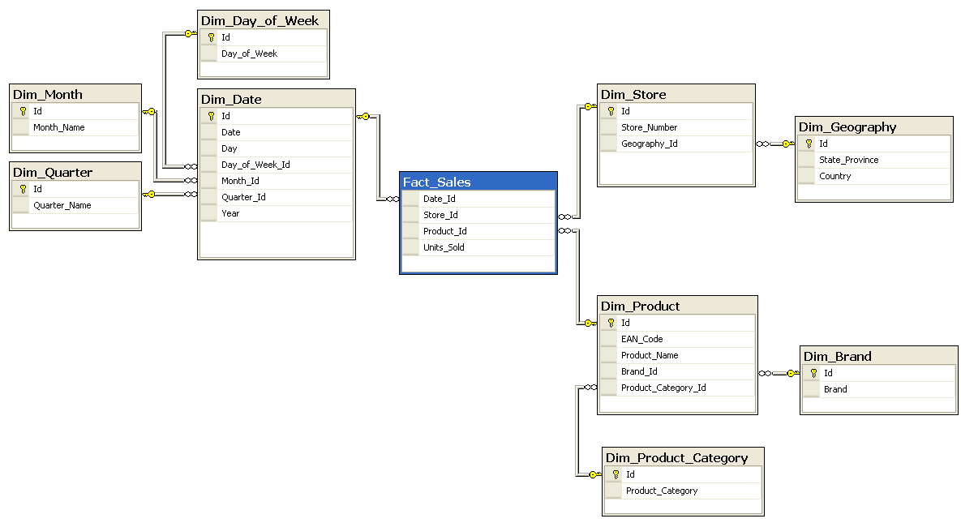
2. Snow Flake Schema: A snow flake schema is an enhancement of star schema by adding additional dimensions. Snow flake schema are useful when there are low cardinality attributes in the dimensions.

Slide 12
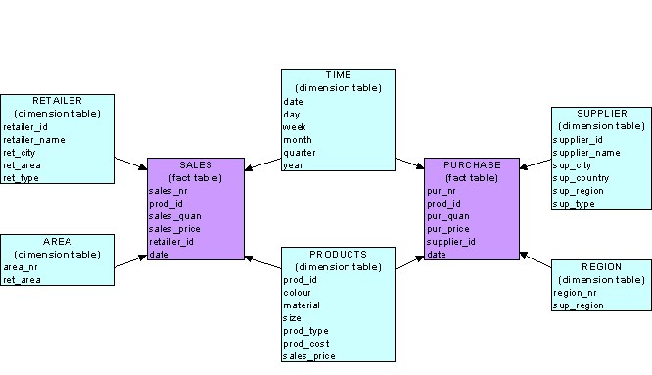
Galaxy Schema: Galaxy schema contains many fact tables with some common dimensions (conformed dimensions). This schema is a combination of many data marts.

Slide 13
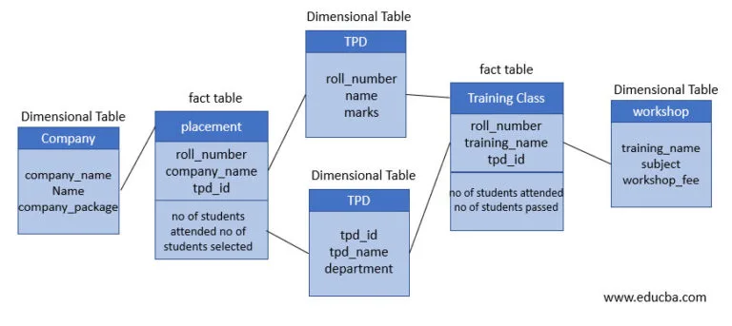
Fact Constellation Schema: The dimensions in this schema are segregated into independent dimensions based on the levels of hierarchy. For example, if geography has five levels of hierarchy like teritary, region, country, state and city; constellation schema would have five dimensions instead of one.

Slide 14
Q.5 Based on your readings, list the key steps to create a new dimensional model?
Step 1: Identify the Business Processes Before modeling the data, you should types of dimensional modelling are appropriate for your data model. The dimensional modeling process (or any type of data modelling) begins with the identification of the business process that you want to track. Step 2: Identify Facts and Dimensions in Your Dimensional Data Model The information in a dimensional model is categorized into two tables types – Facts and Dimensions. The next step is to identify the business facts that you want to measure and their associated dimensions. Step 3: Identify the Attributes for Dimensions After you’ve identified the facts and dimensions for your business process, the next step is to identify attributes and create a separate dimensional table for each of the dimensions. There are different types of dimensional tables for each data type. Each record in the dimension table should have a unique key. This key will be used to uniquely identify the records in the dimension table and will be used as the foreign key in the fact table to reference the particular dimension and join it with the fact table Step 4: Define the Granularity for Business Facts Granularity refers to the level of information that is stored in any table. The fact tables in a dimensional model should be consistent with the pre-defined granularity.

Slide 15
Refrances:
1. https://www.stitchdata.com/resources/oltp-vs-olap
2. https://www.geeksforgeeks.org/difference-between-kimball-and-inmon
3. https://www.zentut.com/data-warehouse/fact-table
4. https://www.ibm.com/docs/en/ida/9.1.2?topic=design-dimensional-schemas
5. https://www.ibm.com/docs/en/informix-servers/12.10?topic=model-building-dimensional-data

